Slide 1
SQL QUERIES ON PIZZA SALES DATA
ARSHAD ALI

Slide 2
Questions:
Basic:
Retrieve the total number of orders placed.
Calculate the total revenue generated from pizza sales.
Identify the highest-priced pizza.
Identify the most common pizza size ordered.
List the top 5 most ordered pizza types along with their quantities.
Intermediate:
Join the necessary tables to find the total quantity of each pizza category category.
Determine the distribution of orders by hour of the day.
Join relevant tables to find the category-wise distribution of pizzas.
Group the orders by date and calculate the average number of pizzas ordered per day.
Determine the top 3 most ordered pizza types based on revenue.
Advanced:
Calculate the percentage contribution of each pizza type to total revenue.
Analyse the cumulative revenue generated over time.
Determine the top 3 most ordered pizza types based on revenue for each pizza category.

Slide 3
Introduction
In the realm of data analysis, SQL (Structured Query Language) stands out as a fundamental tool for querying and managing data stored in relational databases. This project focuses on analyzing pizza sales data using SQL queries to extract, transform, and analyze the information contained within four CSV files.
The primary goal of this project is to gain insights into various aspects of pizza sales, such as customer preferences, sales trends, and product performance. By utilizing SQL, we can efficiently query the data to answer critical business questions and identify patterns that can inform decision-making.
I used different type of sql queries to extract meaningful data. The difficulty level of questions were basic to advance.

Slide 4
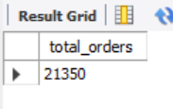
Q1. Retrieve the total number of orders placed.

Slide 5
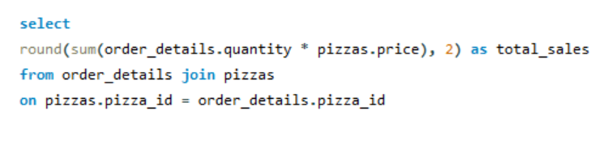
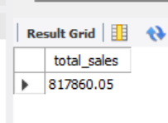
Q2. Calculate the total revenue generated from pizza sales.

Slide 6
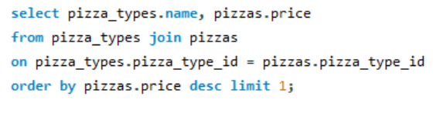
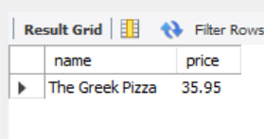
Q3. Identify the highest-priced pizza.

Slide 7
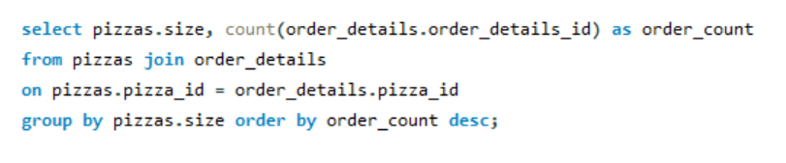
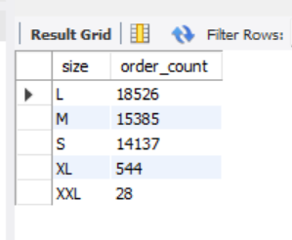
Q4. Identify the most common pizza size ordered.

Slide 8
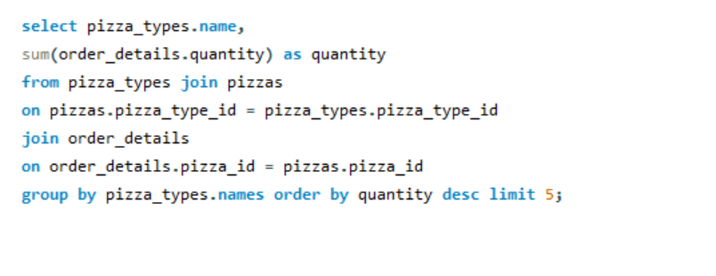
Q5. List the top 5 most ordered pizza types along with their quantities.

Slide 9
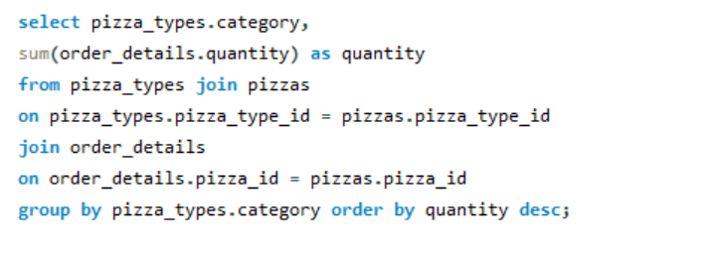
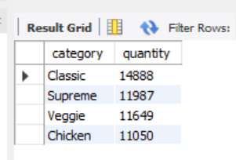
Q6. Join the necessary tables to find the total quantity of each pizza category .

Slide 10
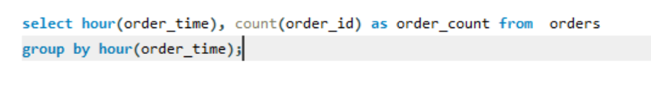
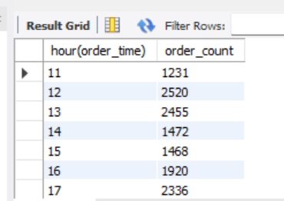
Q7. Determine the distribution of orders by hour of the day.

Slide 11
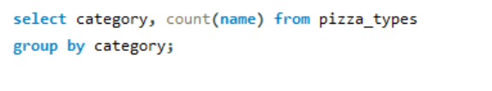
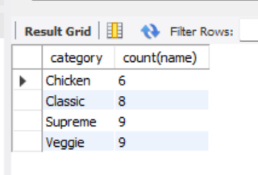
Q8. Join relevant tables to find the category-wise distribution of pizzas.

Slide 12
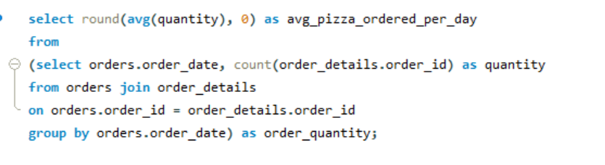
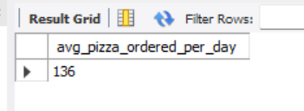
Q9. Group the orders by date and calculate the average number of pizzas ordered per day.

Slide 13
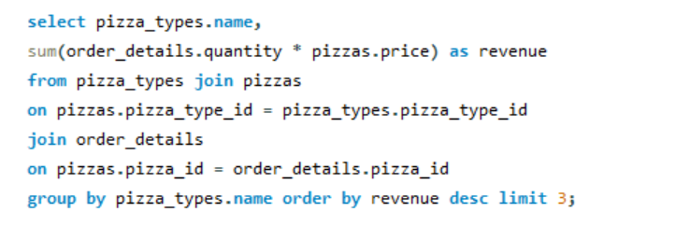
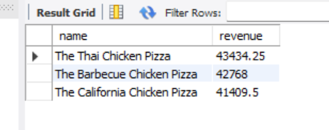
Q10. Determine the top 3 most ordered pizza types based on revenue.

Slide 14
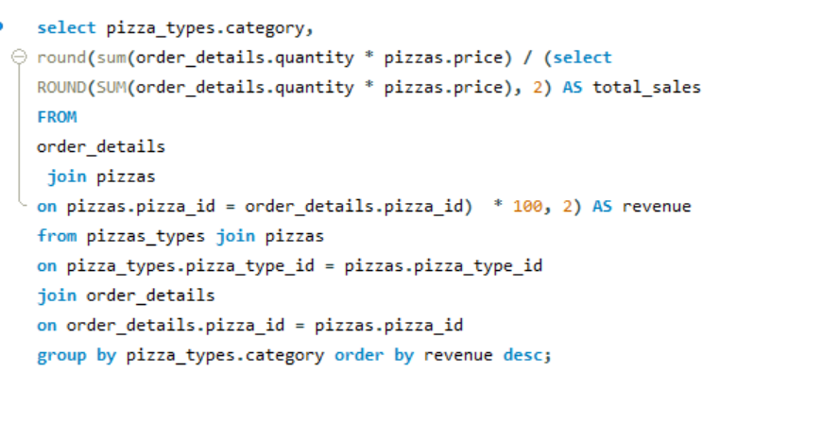
Q11. Calculate the percentage contribution of each pizza type to total revenue.

Slide 15
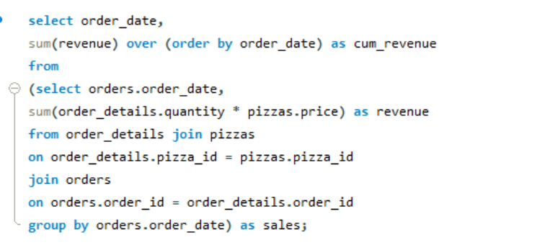
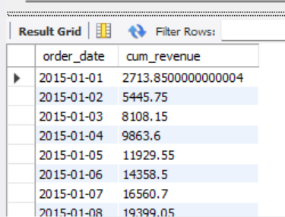
Q12. Analyse the cumulative revenue generated over time.

Slide 16
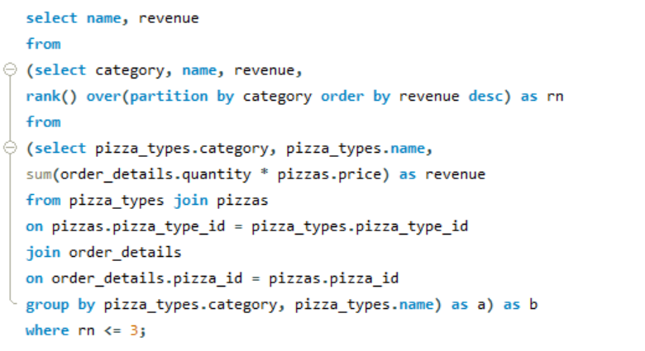
Q13. Determine the top 3 most ordered pizza types based on revenue for each pizza category.

